Slide 1

Social Interaction In Every day's Life

Slide 2
Group Members
Hamza Khan
Sharjeel Qureshi
Abu Bakar
Hashim Saleem

Slide 3

Social Status
Prestige
Rank or Position of individual

Slide 4

Types Of Social Status
Achieved status
Ascribed Status
Master Status

Slide 5
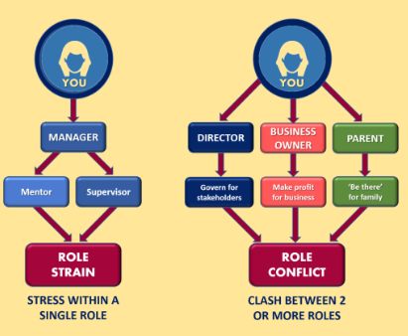
Social Role
Role
Role Set
Role Conflict
Role Strain
Role Exit

